Slide 1
Project Title: Efficient Search and Rescue Operations using Swarm Robots and Drones
Team Members: Chaitanya Varma Rudraraju, Geeth Vishnu
Date: 24-07-2024
Problem Statement Verticals : Smart City with Disaster Management

Slide 2
Problem Statement
Natural disasters like earthquakes, tsunamis, and floods devastate large areas, leaving victims trapped or injured, with the first 72 hours critical for survival. Traditional search and rescue methods face challenges such as vast search areas, limited visibility, delayed response times, and inefficient resource allocation, leading to increased mortality, prolonged suffering, wasted resources, and economic losses. The WHO reports an average of 60,000 disaster-related deaths annually, while the UNDRR highlights increasing disaster impacts due to climate change and urbanization. Drones with thermal imaging can improve detection speed and accuracy, but current technology lacks intelligent algorithms for prioritization and route optimization. An innovative drone-based system can accelerate victim identification, reduce suffering, optimize resource utilization, and enhance disaster response and community resilience.

Slide 3
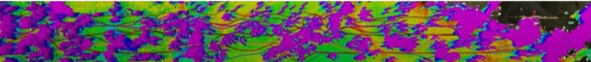
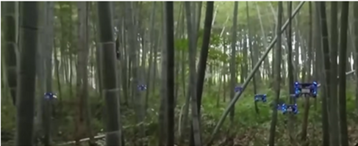
We will primarily use swarm drones to efficiently traverse large areas, sharing information about visited locations and victim data. Recent research by Zhejiang University demonstrated that swarm robots can traverse forests with high accuracy, avoiding 99% of obstacles and providing comprehensive area mapping. This reduces drone loss and improves victim detection. The experiment highlights effective forest mapping using swarm drones, showcasing their capability in complex environments. For a visual demonstration, refer to the video: "Swarm Drones in Action. https://youtu.be/rPul9WKQ6oQ?si=SBqCKQe24VbaIr2r " This technology ensures thorough coverage and efficient victim identification in disaster zones.
How They Effectivly map the for in the experiment
Experiment Conducted By Zhejiang University

Slide 4
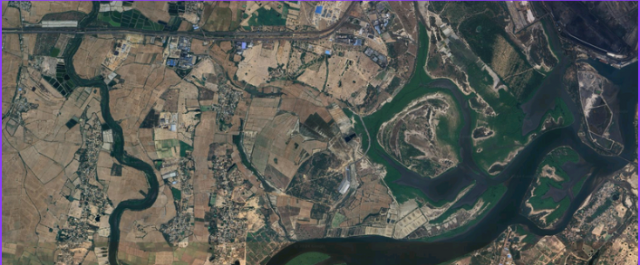
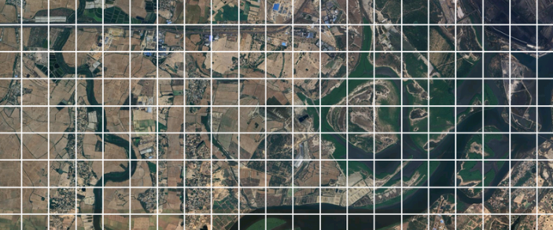
We will be assigned a specific area to cover, which we will divide into sectors between specified latitudes and longitudes for efficient searching. Each sector will initially have a probability of 0.2, indicating a 20% chance of finding people. This ensures equal importance for all sectors from the start. If certain regions are later identified as having a higher likelihood of casualties, their probabilities will be adjusted accordingly, and more resources will be allocated to those areas.
Initial Search Area
After Dividing Into Sectors

Slide 5
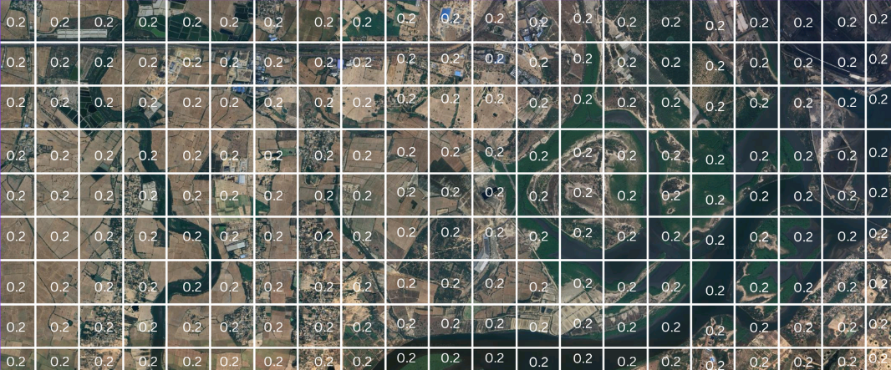
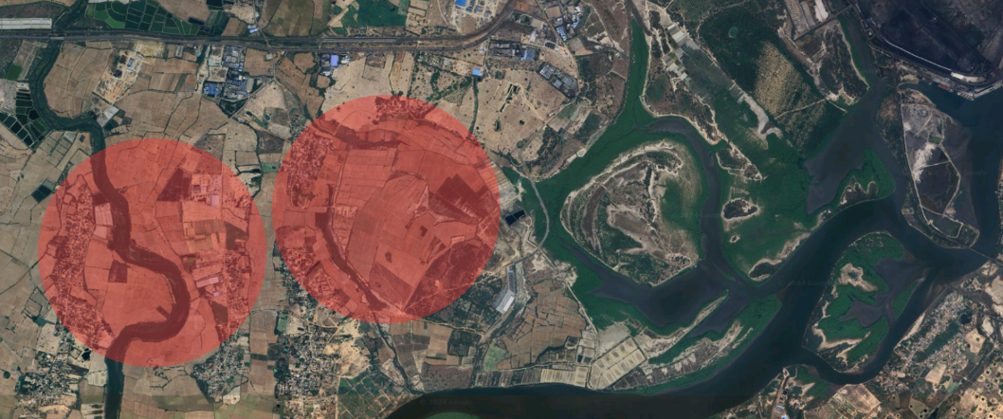
If certain regions are identified as having a higher likelihood of casualties, the central area of the affected zone will be assigned a high probability of finding casualties. Adjacent regions, expected to have fewer but still significant casualties, will be given slightly lower probabilities compared to the central area. This approach prioritizes the most critical sections while ensuring neighboring areas also receive attention based on their likelihood of containing casualties.
In the following image, the red zones represent areas with a high likelihood of casualties. These red zones should be clearly marked before starting the operation to prioritize them for immediate attention. Probabilities will be assigned to each sector based on these marked areas, facilitating the search for casualties. Higher probabilities will be assigned to regions with a higher likelihood of casualties, focusing resources and efforts on the most critical areas.
Assigning The 0.2 Probability for all the regions
Probability of having more number of casualities
Areas Likely Having Higher rate of Casuality

Slide 6
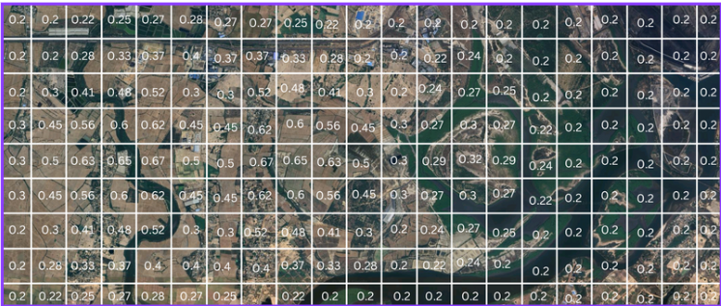
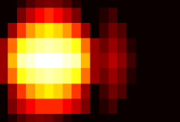
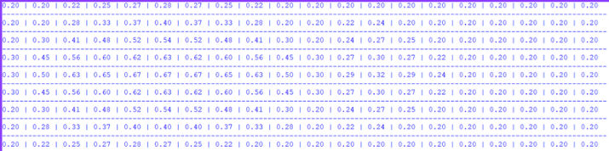
Based on the assigned probability values, we will create a matrix to determine the most efficient path for our swarm drones. This path will cover every possible sector, optimizing the search process to locate casualties and injuries effectively. Here's how the matrix might look and how we can use it to create a heatmap and determine the path
Heat Map Of Probabilities
Values Assigned To Each Location
Probability Matrix

Slide 7
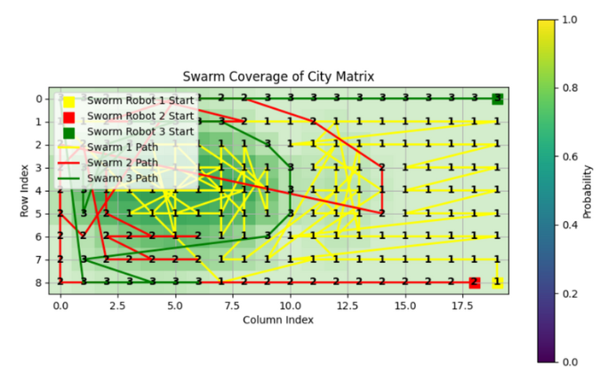
Path Navigation for Swarms: Multi-Start Heuristic Path Navigation
Algorithm Overview
Initialization:
Robot Placement: Initialize the positions of the swarm robots outside the matrix.
Matrix Flattening: Convert the forest matrix into a list of sectors, each with its probability and coordinates. Sort this list in descending order by probability.
Sector Assignment:
Closest Robot Selection: For each sector, identify the swarm robot that is closest in terms of Manhattan distance.
Sector Assignment: Assign the sector to the closest robot.
Position Update: Update the position of the chosen robot to the current sector's location.
Tracking Coverage: Maintain a list to track each robot's coverage, allowing for visualization of the sectors covered by each robot.
Explanation
Initialize Robot Positions: The robots are initialized outside the matrix.
Matrix Flattening: The matrix is flattened into a list of sectors, sorted by probability in descending order.
Sector Assignment: Each sector is assigned to the closest robot, and the robot's position is updated.
Tracking Coverage: Each robot's coverage is tracked for visualization.
The visualization shows the paths each robot will take, ensuring comprehensive coverage of the entire area with a focus on high-probability sectors. This method allows efficient allocation of resources and thorough searching of all sectors.

Slide 8
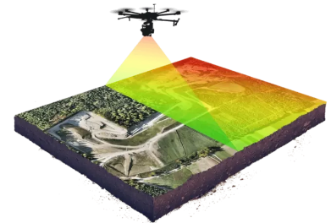
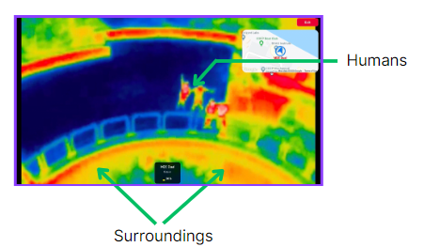
Using LiDAR and Thermal Sensors for Effective Search and Rescue Operations
LiDAR for Mapping:
Detailed Terrain Mapping: Provides high-resolution, 3D representations of the environment.
Obstacle Detection: Identifies obstacles and debris for better planning.
Accurate Sector Analysis: Ensures comprehensive coverage and resource allocation.
Finding People and Assessing Criticality with Thermal Sensors:
Heat Signature Detection: Identifies living beings, even in debris-filled areas.
Criticality Assessment: Distinguishes between healthy, slightly injured, heavily injured, and deceased individuals.
Enhanced Search Efficiency: Makes it easier to find people in challenging surroundings.
Comprehensive Search Strategy:
LiDAR Mapping: Generate detailed maps and identify obstacles.
Thermal Sensors: Locate heat signatures and assess individual conditions.
Optimization and Execution: Use probability matrix and heuristic algorithms to optimize search paths with swarm drones.
By combining LiDAR and thermal sensors, search and rescue operations become more precise and efficient, ensuring comprehensive coverage and prioritizing critical areas.
How Thermal Helps Us to Find The People
How Drone Covers The Complete Area

Slide 9
Combination of LiDAR and Camera Systems for Search and Rescue
LiDAR and Camera Integration:
LiDAR: Creates detailed maps and detects human shapes.
Cameras with Image Processing: Identifies if detected shapes are injured persons.
Value Assignment Scheme:
Healthy (1): Normal vital signs and movement.
Not Much Injured (0.75): Minor injuries, normal vital signs, and some movement.
Medium Injured (0.5): Noticeable injuries, some impact on vital signs and movement.
Highly Injured (0.25): Severe injuries, significant impact on vital signs, little to no movement.
Deceased (0): No vital signs or movement.
Data Processing Workflow:
Data Collection: Gather data from thermal imaging, UWB radar, cameras, acoustic sensors, LiDAR, and CO2 detectors.
Preprocessing: Remove noise and enhance signal quality.
Feature Extraction: Extract features like body temperature, heart rate, respiration rate, and movement patterns.
Classification: Use algorithms to classify injury status.
Value Assignment: Assign values based on classification results.
This integrated approach ensures precise identification and assessment of individuals in disaster zones.
Output: The drone transmits the results to the control center, indicating each individual’s location and assigned status.

Slide 10
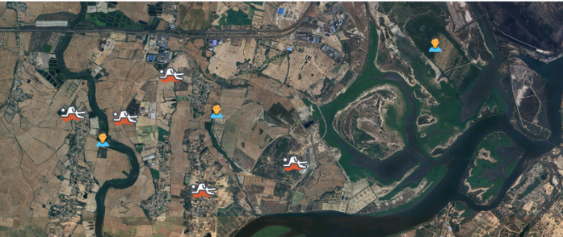
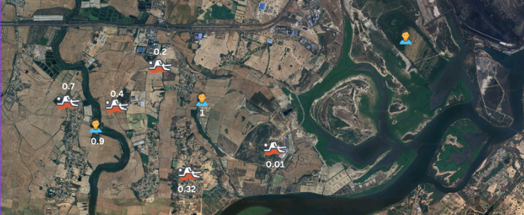
Assessing and Mapping Injured Individuals
Criticality Value Assignment:
0: Deceased
0.25: Severely Injured
0.5: Injured
0.75: Mildly Injured
1: Healthy/Not Injured
Process:
Identify Individuals: Use sensor data to locate and identify individuals.
Assign Criticality: Determine the criticality level based on their condition.
Map Conversion: Convert criticality values into a matrix for visual representation.
This approach allows efficient traversal and prioritization in rescue operations, ensuring that individuals are assessed and attended to based on their urgency.
Finding The People On The Map So That We Can Rescue them
Assigning Criticality to each person

Slide 11
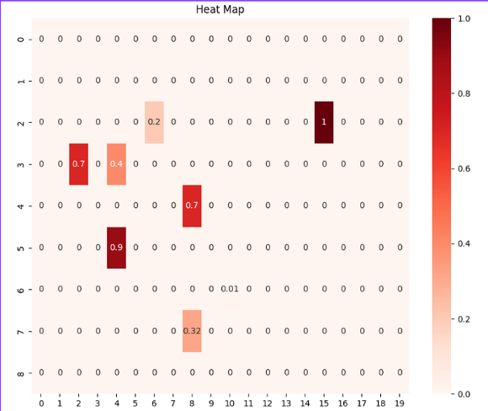
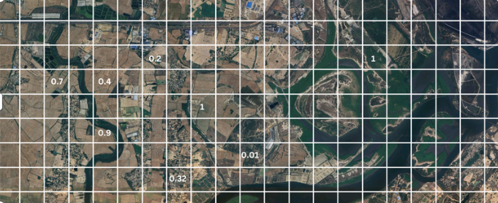
We will integrate the values into a matrix as follows
Matrix Representation:
Empty Columns: For columns with no data or empty sectors, we will assign a value of 0 to indicate that no significant information or casualties were detected in those areas.
Critical Values: For sectors where critical values have been determined, we will populate the matrix with these values to represent the severity of conditions in those sectors.
This approach ensures that the matrix accurately reflects the status of each sector, with a clear representation of both unoccupied areas and those with critical information.

Slide 12
Efficient Pathfinding Algorithm for Critical Sectors.
Algorithm Overview
Initialization:
Extract Coordinates & Critical Values:
Identify non-zero sectors and their critical values.
Set Up Data Structures:
Initialize a priority queue (heap) for sector exploration.
Use a set to track visited sectors.
Matrix Representation:
Matrix displays sectors with critical values indicating severity.
Traversing the Matrix:
Swarm Robots:
Robots start from the initial point, following the algorithm to cover critical sectors.
Path Optimization:
Prioritize high-priority sectors for efficient traversal.
Traversal Using Priority Queue:
Start at Initial Point:
Begin with an initial weight of 0.
Process the Priority Queue:
Pop the sector with the lowest weighted distance.
Calculate and adjust the distance based on sector’s critical value.
Push weighted distances into the heap.
Mark sectors as visited.
This algorithm ensures that high-criticality sectors are prioritized, optimizing coverage and efficiency in search and rescue operations.

Slide 13
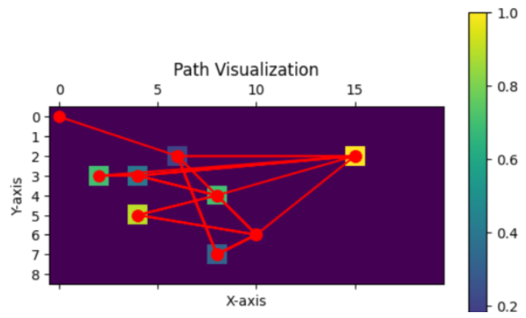
Formula To Find The next best possible point for which has lower distance and more criticality
Weight = Ecludian_Distance (1 / Critical_Value)
This is how we will traverse the entire map using the most optimized route, prioritizing critical values.

Slide 14
Conclusion
In this project, we developed an efficient algorithm to traverse a matrix-based map while prioritizing critical values. By utilizing a combination of Euclidean distance and weighted critical values, our approach optimizes the route to cover all significant points effectively. This method ensures that the most critical areas are addressed first, improving the overall efficiency and effectiveness of the traversal. The visualization of the path highlights the optimized route and demonstrates how the algorithm prioritizes high-value areas, offering valuable insights into practical applications such as search and rescue operations in disaster zones.
Scope for Improvement
The path navigation for multiple swarm robots requires significant enhancement, and I plan to conduct further research to address this. Additionally, the formula I developed can be refined to better determine the next optimal point for assessing casualties.

